Slide 1
Ancient Civilizations

Slide 2
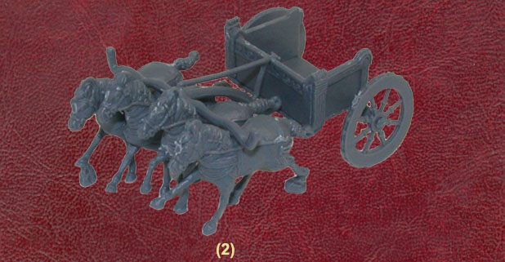
Hittites – A Warring People
2000 BCE controlled Anatolia (Asia Minor/ Turkey)
Formed an empire about 1650 BCE
Dominated SW Asia for about 450 years
Hittite occupied Babylon and blended cultures
Had superior weapons
Iron weapons and chariots (these were light and easily maneuverable)
Hittite control ended in 1190 B. C.E.

Slide 3
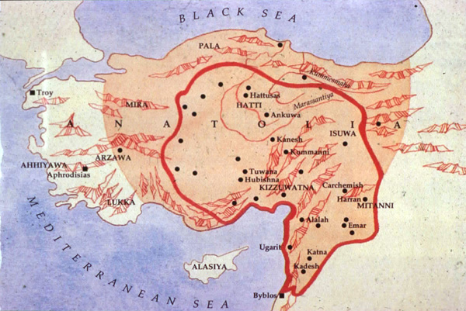
Hittite Empire

Slide 4
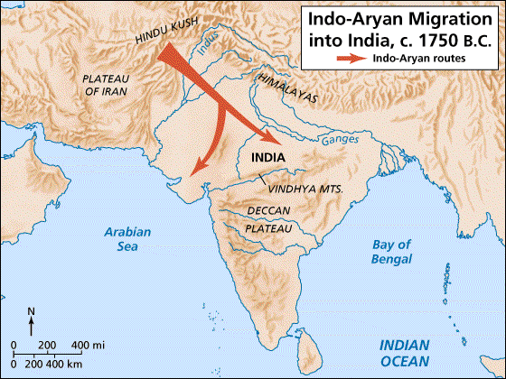
Ancient Civilizations
Aryans (the Nobles) – Invaders to Indus Region-Stuff we already know! ☺
Invaded the Indus River Valley
Brought sacred literature: Vedas
Collection of prayers, spells, instructions for rituals, & hymns
Were oral for thousands of years…were these accurate?
Historical poem: Mahabharata

Slide 5
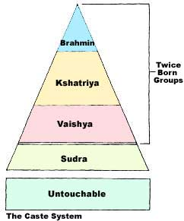
Aryans (more stuff we know)
Caste System
Aryans established superiority
Taller, lighter skin, & different language
Had no writing system
Counted wealth in cows
Offered sacrifices to many gods
Divided by social classes
Brahmin (priests), warriors, peasants/traders, craftsmen(non-Aryan)

Slide 6
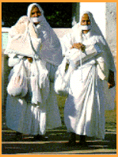
Hinduism
Hinduism develops over time
Polytheistic; no founder
Other important books: Upanishads
A dialog between teacher and student regarding Moksha (perfect understanding and release from reincarnation)
Reincarnation depends on Karma
Jainism
Extreme ideas regarding Ahimsa (non-violence)
All things have a soul and shouldn’t be harmed (pg 63)
5 million Jains in India today

Slide 7
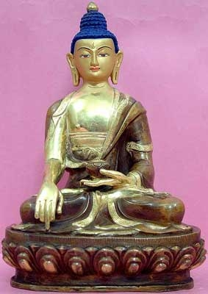
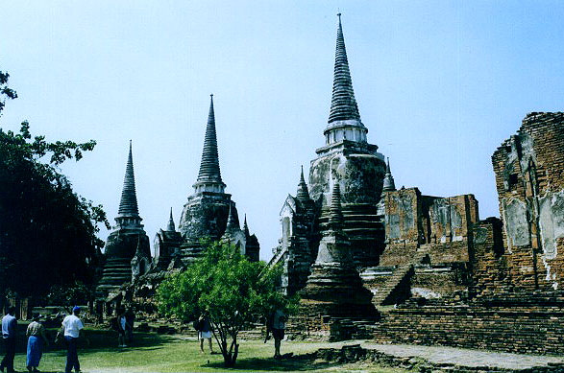
Buddhism(we know this!)
Siddhartha Gautama (563-483 BCE)
Noble family
Went out seeking enlightenment
Found it after meditating under a tree
Became known as Buddha (the Enlightened One)
4 Noble Truths
8 Fold Path
Nirvana!
Rejected the Caste System
All are welcome ☺..Which Hindu’s would be drawn to Buddhism?
Didn’t take hold in India; more so in Asia due to trading (cultural diffusion again)
Sacred mounds still exist that are said to contain his relics
Stupas

Slide 8
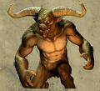
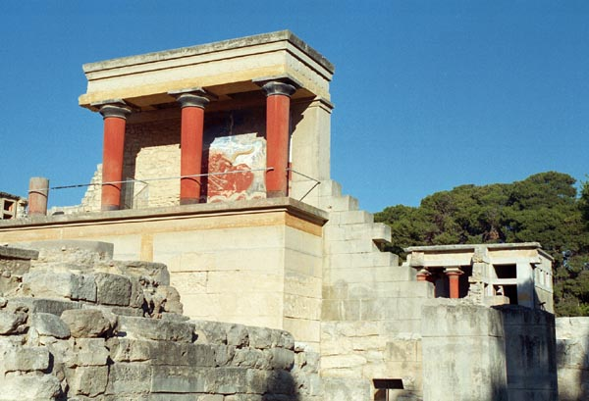
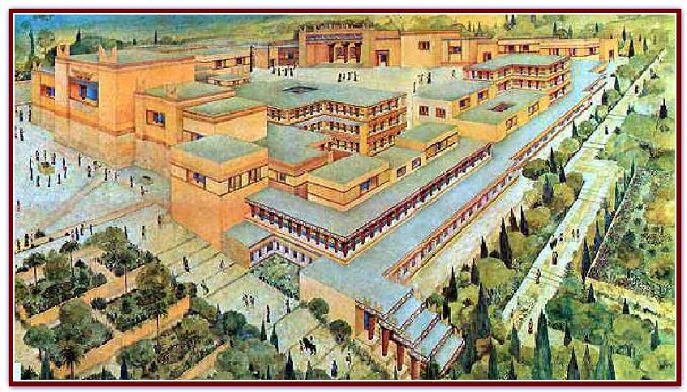
Minoans
Minoans
Lived on Crete
Capital city: Knossos
Run by King Minos who had a Minotaur
Ended mysteriously around 1200 BCE
Maybe earthquakes and then taken over by Greeks

Slide 9
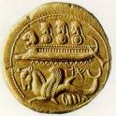
Phoenicians
Phoenicians
1200-1000BCE
Great sea traders and ship builders
Located where Lebanon is today
Many city-states for ports/trade
Tyre: they had purple dye
Carthage: will become an enemy of Rome
Greatest Legacy: The alphabet
Greeks adopted, then English “borrowed”

Slide 10
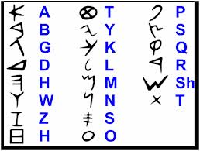
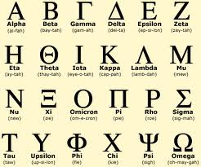
Phoenician and Greek Alphabets

Slide 11
Ancient Civilizations
Hebrews – Known as the Jews
Settled Canaan, part of ancient Palestine (Middle East)
According to the Bible, the land was promised to them by God
History of the Hebrews found in the Torah ( 1st 5 books of the Old Testament)
Abraham – “Father” of the Hebrew people
- shepherd who lived in Ur; about 2000BCE
- told by God to “go to a land I will show you, that I may make you the father of a great nation”

Slide 12
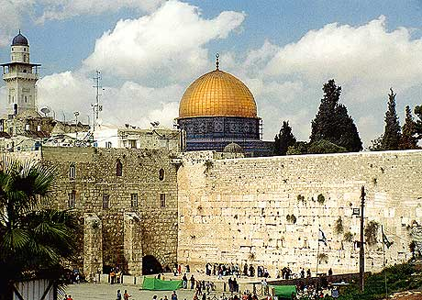
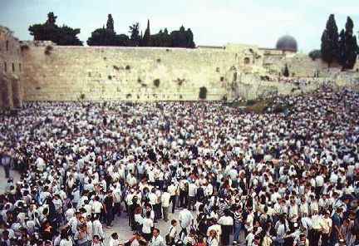
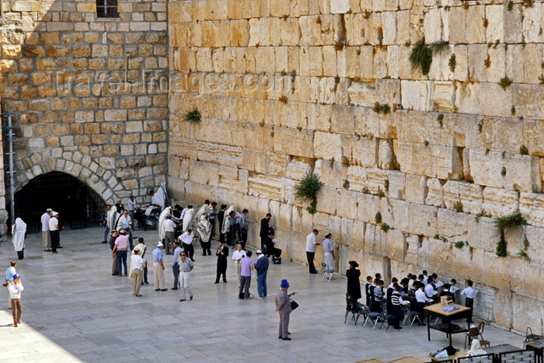
Western (Wailing) Wall

Slide 13
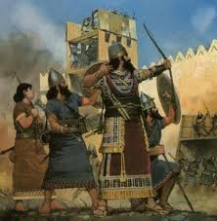
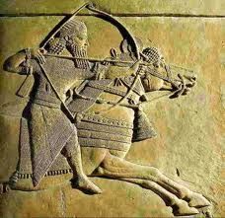
Ancient Civilizations
Assyrians - fierce warriors
From northern Mesopotamia around 1400BCE
Defeated Syria, Palestine, Babylon, Egypt, & Anatolia
Had great weapons and organized army
Spoke Aramaic
Required tax and tribute (Hebrews)
Cruel to those they conquered…really cruel

Slide 14
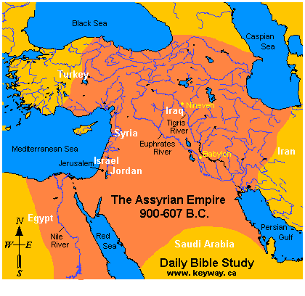
Assyrian Empire

Slide 15
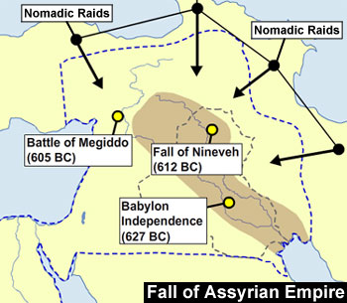
Many bloody attacks on villages
Would skin people just to send a message…what message?
850-650 BCE expanded Empire all the way from the FC to Egypt to Anatolia
Fall
Spread too thin
Cruelty was coming back to hurt them; resentment
Destroyed by the Chaldeans

Slide 16


Ancient Civilizations
Persians – Largest Empire on Earth…some say
Ruled conquered lands with tolerance and diplomacy
Strong military to conquer and protect lands
Cyrus the Great expanded the empire
Great military leader
Showed kindness toward conquered people
Honored local customs and religious practices
Instead of destroying a conquered people’s temple he would kneel and pray at the temple! Why?
Allowed Jews to return to their homeland
Cambyses: son of Cyrus…many thought he was too harsh and perhaps had a mental disorder

Slide 17

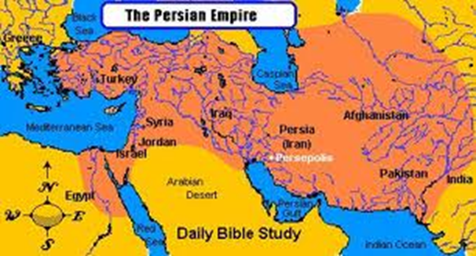
Ancient Civilizations
Persia Continued
Next ruled by Darius, originally the bodyguard of the king, who seized the throne in 522 B.C.E.
Established a well organized government & administration
Extended the empire from Anatolia to Egypt
Divided the empire into 20 provinces with governors
Sent out governors to be the “eyes and ears of the king” (satraps)
Many diverse groups under Persia’s control

Slide 18
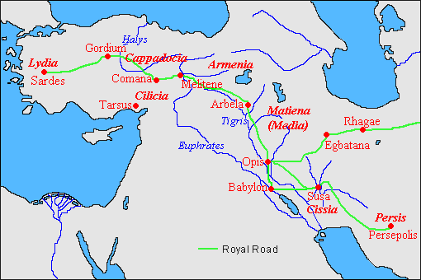
Royal Road
United the empire
1,677 miles long
111 relay stations (rest stops)
Used a common currency
Not just goods were traded…what else?
Practiced Zoroastrianism
Taught there is a battle for one’s soul between good(ahuramazda)/evil(ahuraman)
Those who chose good would not be doomed to the underworld
Eventually defeated by Alexander the Great

